Slide 1
Essential Introduction to Computers
and How to Purchase a Personal Computer

Slide 2
Objectives
Define the term computer and discuss the four basic computer operations: input, processing, output, and storage
Define data and information
Explain the principal components of the computer and their use
Describe the use of magnetic disks, USB flash drives, and other storage media
Discuss computer software and explain the difference between system software and application software

Slide 3
Objectives
Identify several types of personal computer application software
Discuss computer communications channels and equipment and the Internet and World Wide Web
Define e-commerce
Explain how to purchase a personal computer

Slide 4
What is a Computer?
An electronic device, operating under the control of instructions stored in its own memory, that can:
Accept data (input)
Process the data according to specified rules (process)
Produce results (output)
Store the results for future use (storage)

Slide 5
What is a Computer?

Slide 6
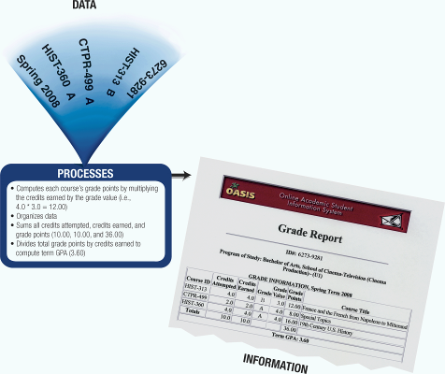
What Does a Computer Do?
Four basic operations compromise the information processing cycle

Slide 7
What are the Components of a Computer?
The six primary components of a computer are input devices, the processor (control unit and arithmetic/logic unit), memory, output devices, storage devices, and communications devices
The processor, memory, and storage devices are housed in a box-like case called the system unit

Slide 8
What are the Components of a Computer?

Slide 9
Input Devices
An input device is any hardware component that allows you to enter data, programs, commands, and user responses into a computer
A keyboard is an input device that contains keys you press to enter data into the computer
A stylus is a small metal or plastic device that looks like a ballpoint pen, but uses pressure instead of ink to write, draw, or make selections
Smart phones often include a digital camera so users can send pictures and videos to others

Slide 10
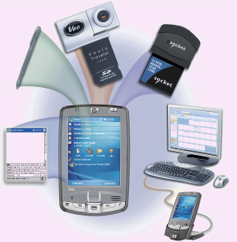
Input Devices

Slide 11
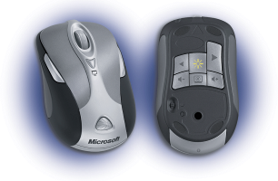
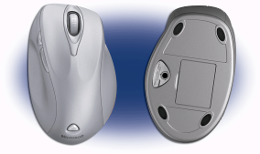
Input Devices
A mouse is a pointing device that fits comfortably under the palm of your hand
Pointer or mouse pointer
Most notebook computers come with a touchpad

Slide 12
System Unit
The system unit is a case that contains electronic components of the computer used to process data
The processor (CPU) interprets and carries out the basic instructions that operate a computer
Arithmetic/logic unit
Memory (RAM) consists of electronic components that temporarily stores instructions waiting to be executed by the processor, data needed by those instructions, and the results of processed data

Slide 13
System Unit

Slide 14
Output Devices
Output devices make the information resulting from processing available for use
An impact printer prints by striking an inked ribbon against the paper
Nonimpact printers form characters by means other than striking a ribbon against paper
Inkjet
Photo printers
Laser

Slide 15
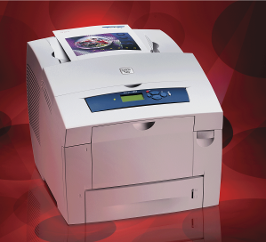
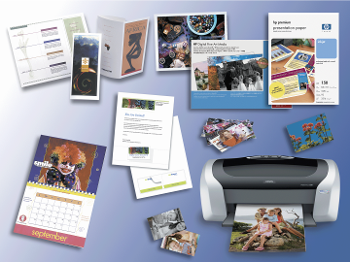
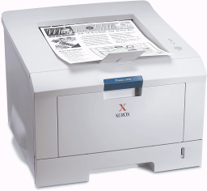
Output Devices

Slide 16
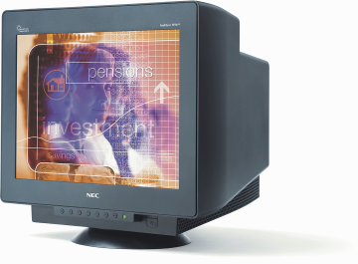
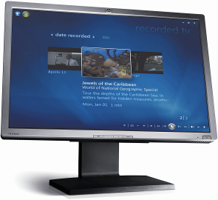
Display Devices
A display device is an output device that visually conveys text, graphics, and video information
Monitor
Flat panel monitor
LCD
CRT

Slide 17
Display Devices

Slide 18
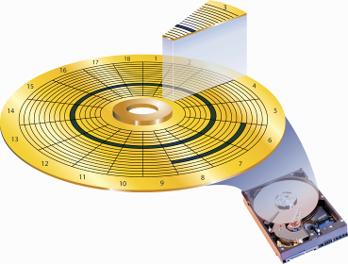
Storage Devices
A storage device is used to store instructions, data, and information when they are not being used in memory
Magnetic disks use magnetic particles to store items on a disk’s surface
Formatting
Track
Sectors
Portable storage medium

Slide 19
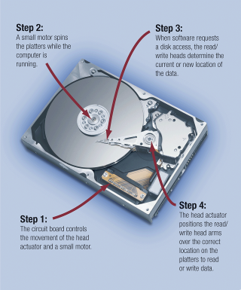
Storage Devices
A hard disk is a storage device that contains one or more inflexible, circular platters that magnetically store data, instructions, and information
Head crash
Backup

Slide 20
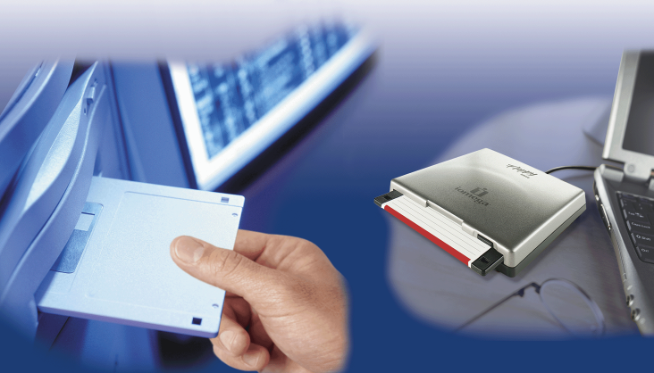
Storage Devices
A floppy disk is an inexpensive portable storage medium

Slide 21
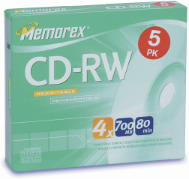
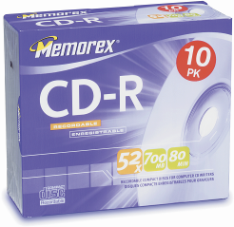
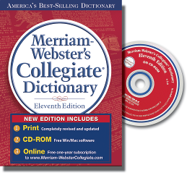
Storage Devices
An optical disc is a portable storage medium that consists of a flat, round, portable disc made of metal, plastic, and lacquer that is written and read by a laser

Slide 22
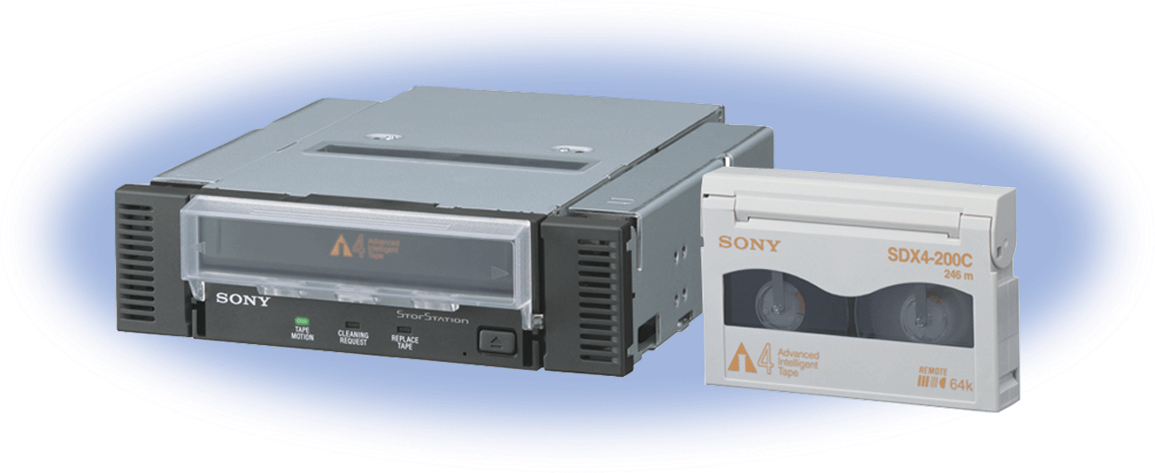
Storage Devices
Tape is a magnetically coated ribbon of plastic housed in a tape cartridge
Tape drive

Slide 23
Storage Devices
Miniature mobile storage media are rewriteable media usually in the form of a flash memory card, USB flash drive, or a smart card

Slide 24
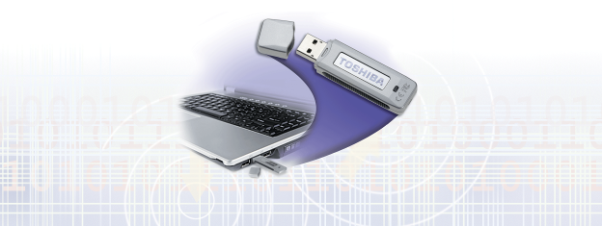
Storage Devices

Slide 25
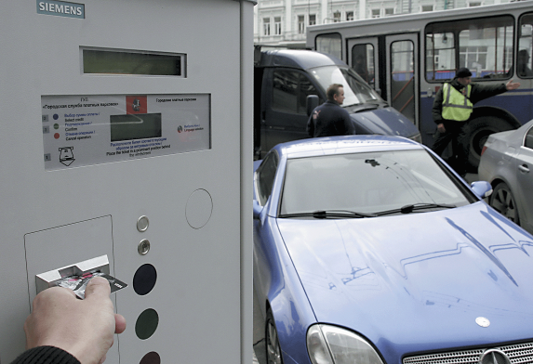
Storage Devices
A smart card stores data n a thin microprocessor embedded in the card

Slide 26
Communications Devices
A communications device is a hardware component that enables a computer to send and receive data, instructions, and information to and from one or more computers
Transmission media

Slide 27
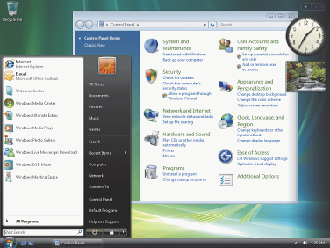
Computer Software
System software consists of programs to control the operations of computer equipment
Operating system
Microsoft Windows Vista
Microsoft Windows XP
Apple Mac OS X
Linux
Booting
Graphical user interface (GUI)
Icon

Slide 28
Computer Software
Application software consists of programs designed to make users more productive and/or assist them with personal tasks
Word processing
Spreadsheet
Database
Presentation graphics

Slide 29
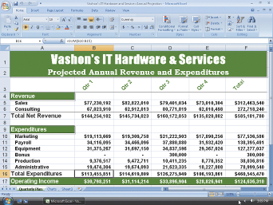
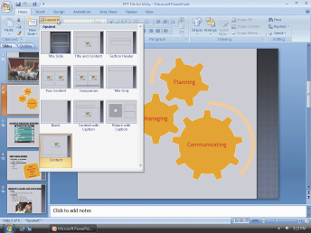
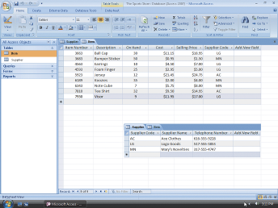
Computer Software

Slide 30
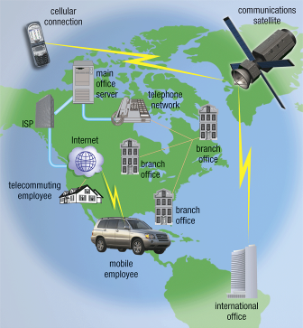
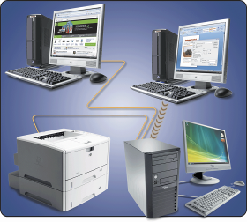
Networks and the Internet
A network is a collection of computers and devices connected together, often wirelessly, via communications devices and transmission media
Local area network
Wide area network

Slide 31
Networks and the Internet
The world’s largest network is the Internet, which is a worldwide collection of networks that connects millions of businesses, government agencies, educational institutions, and individuals
Internet service provider (ISP)
Online service provider (OSP)
Wireless Internet service provider (WISP)

Slide 32
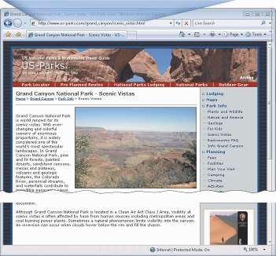
Networks and the Internet
The World Wide Web contains billions of documents called Web pages
Web page
Web site
Web browser
Uniform Resource Locator (URL)
Hypertext transfer protocol

Slide 33
Networks and the Internet
When you conduct business activities online, you are participating in electronic commerce, also known as e-commerce
Business to consumer (B2C)
Consumer to consumer (C2C)
Business to business (B2B)

Slide 34
How to Purchase a Personal Computer
Do you want a desktop computer or mobile computer?
For what purposes will you use the computer?
Should the computer be compatible with the computers at school or work?

Slide 35
How to Purchase a Desktop Computer
Determine the specific software you want to use on your computer
Know the System Requirements of the Operating System
Look for bundled software
Avoid buying the least powerful computer available
Consider upgrades to the mouse, keyboard, monitor, printer, microphone, and speakers

Slide 36
How to Purchase a Desktop Computer
Determine whether you want to use telephone lines or broadband (cable or DSK) to access the Internet
If you are using a dial-up or wireless connection to connect to the Internet, then select an ISP or OSP
Use a worksheet to compare computers, services, and other considerations
If you are buying a new computer, you have several purchasing options: buying from your school bookstore, a local computer dealer, a local large retail store, or ordering by mail via telephone or the Web
If you are buying a used computer, stay with name brands such as Dell, Gateway, Hewlett-Packard, and Apple

Slide 37
How to Purchase a Desktop Computer
If you have a computer and are upgrading to a new one, then consider selling or trading in the old one
Be aware of hidden costs
Consider more than just price
Avoid restocking fees
Use a credit card to purchase your new computer
Consider purchasing an extended warranty or service plan

Slide 38
How to Purchase a Notebook Computer
Purchase a notebook computer with a sufficiently large active-matrix screen
Experiment with different keyboards and pointing devices
Make sure the notebook computer you purchase has a CD and/or DVD drive
If necessary, upgrade the processor, memory, and disk storage at the time of purchase

Slide 39
How to Purchase a Notebook Computer
The availability of built-in ports and a port extender on a notebook computer is important
If you plan to use your notebook computer for note-taking at school or in meetings, consider a notebook computer that converts to a Tablet PC
Purchase a notebook computer with a built-in wireless network connection
If you are going to use your notebook computer for long periods without access to an electrical outlet, purchase a second battery

Slide 40
How to Purchase a Notebook Computer
Purchase a well-padded and well-designed carrying case
If you travel overseas, obtain a set of electrical and telephone adapters
If you plan to connect your notebook computer to a video projector, make sure the notebook computer is compatible with the video projector
For improved security, consider a fingerprint scanner

Slide 41
How to Purchase a Tablet PC
Make sure the Tablet PC fits your mobile computing needs
Decide whether you want a convertible or pure Tablet PC
Be sure the weight and dimensions are conducive to portability
Port availability, battery life, and durability are even more important with a Tablet PC than they are with a notebook computer

Slide 42
How to Purchase a Tablet PC
Experiment with different models of the Tablet PC to find the digital pen that works best for you
Check out the comfort level of handwriting in different positions
Make sure the LCD display device has a resolution high enough to take advantage of Microsoft’s ClearType technologies
Test the built-in Tablet PC microphone and speakers

Slide 43
How to Purchase a Tablet PC
Consider a Tablet PC with a built-in PC video camera
Review the docking capabilities of the Tablet PC
Wireless access to the Internet and your e-mail is essential with a Tablet PC
Review available accessories to purchase with your Tablet PC

Slide 44
How to Purchase a Personal Mobile Device
Determine the programs you plan to run on your device
Consider how much you want to pay
Determine whether you need wireless access to the Internet and e-mail or mobile telephone capabilities with your device
For wireless devices, determine how and where you will use the service

Slide 45
How to Purchase a Personal Mobile Device
Make sure your device has enough memory and storage
Practice with the touch screen, handwriting recognition, and built-in keyboard before deciding on a model
Decide whether you want a color display
Compare battery life

Slide 46
How to Purchase a Personal Mobile Device
Seriously consider the importance of ergonomics
Check out the accessories
Decide whether you want additional functionality
Determine whether synchronization of data with other devices or personal computers is important

Slide 47
Summary
Define the term computer and discuss the four basic computer operations: input, processing, output, and storage
Define data and information
Explain the principal components of the computer and their use
Describe the use of magnetic disks, USB flash drives, and other storage media
Discuss computer software and explain the difference between system software and application software

Slide 48
Summary
Identify several types of personal computer application software
Discuss computer communications channels and equipment and the Internet and World Wide Web
Define e-commerce
Explain how to purchase a personal computer

Slide 49
Essential Introduction to Computers
Complete

